Slide 1
Laboratory Medicine Core Data Analysis
Lesson 6
Statistics

Slide 2
Objectives
Be able to…
Calculate basic statistical calculations for groups within a data set
Use standard statistical modeling functions
Compare variables’ distributions

Slide 3
Typical Data Science Pipeline
From R for Data Science (https://r4ds.had.co.nz/introduction.html)
Notes:
In this session we will focus on modeling. But, in the process, we will do a lot more data transformation

Slide 4
Using summary to calculate statistics

Slide 5
Basic statistics functions
Central Tendency and Variability
Function | What it Calculates
mean(x) | Mean of the numbers in vector x.
median(x) | Median of the numbers in vector x
var(x) | Estimated variance of the population from which the numbers in vector x are sampled
sd(x) | Estimated standard deviation of the population from which the numbers in vector x are sampled
scale(x) | Standard scores (z-scores) for the numbers in vector x
https://www.dummies.com/education/math/statistics/base-r-statistical-functions/

Slide 6
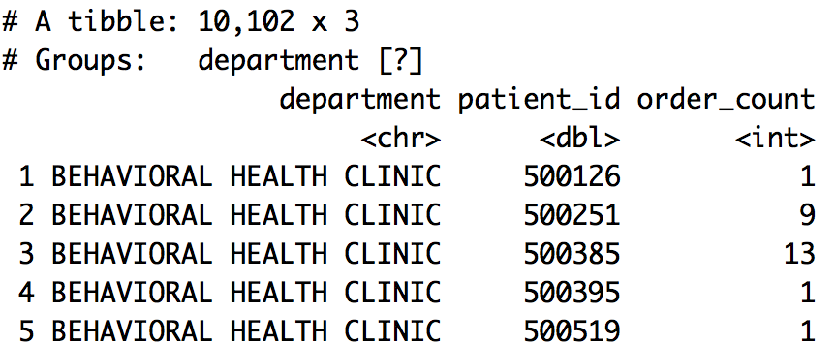
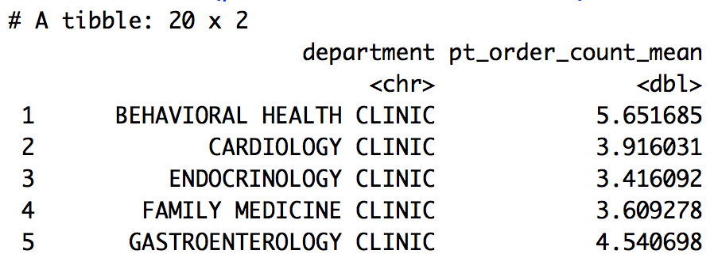
Combining group by, summarize, and statistics functions
orders %>%
group_by(department, patient_id) %>%
summarize(order_count = n()) %>%
summarize(pt_order_count_mean = mean(order_count))
1
2
1
2
Notes:
Finally, the second summarize() calculates the mean order_count across patients separately within each department (group). The final result is an ungrouped data frame, because the second summarize() rolls up the department groups.

Slide 7
Your Turn 1
Run the setup chunk in this lesson’s Rmd if you haven’t already.
In addition to the mean, for each department, calculate the median number of orders per patient and the standard deviation of the number of orders per patient. Assign to an object called
stats_1.

Slide 8
Explore packages for more advanced stats
https://cran.r-project.org/web/packages/moments/moments.pdf
Notes:
Base R may not have all the functions you need for more advanced calculations

Slide 9
Your Turn 2
Install the “moments” package using the install.packages() function and load it using the library() function.
For each department, calculate the skew and kurtosis for the distribution of orders per patient within the department.
Assign to an object called stats_2.

Slide 10
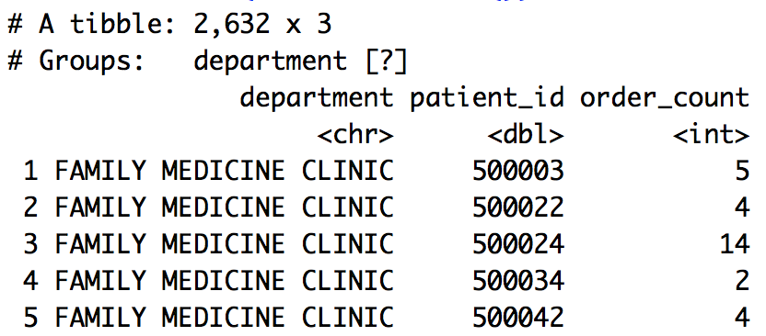
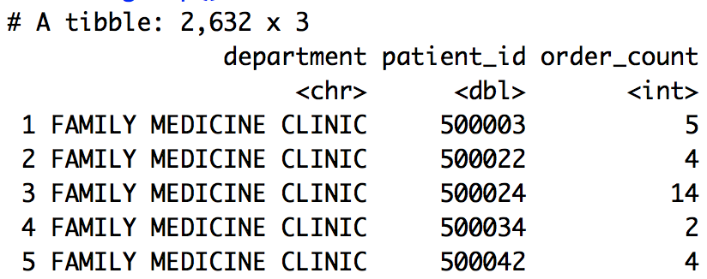
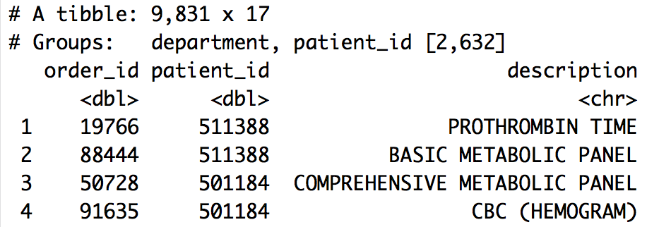
Compare sample distributions
Create the order counts per patient for 2 departments
orders %>%
filter(department %in% c("INTERNAL MEDICINE CLINIC",
"FAMILY MEDICINE CLINIC")) %>%
group_by(department, patient_id) %>%
summarize(order_count = n()) %>%
ungroup() -> orders_per_pt_dept
1
2
3
Notes:
Underlying question:
Is the distribution of the count of orders per patient different in the Internal Medicine and Family Medicine clinics?
Here we calculate order counts for all department-patient_id combinations and then only keep 2 specific departments. As we said before, this would be more efficient if the filter() were applied before the group_by()-summarize()
Also, note the use of the function ungroup(). This does what is sounds like. It undoes or rolls up all groups, returning an ungrouped data frame. This is necessary in this code chunk, because summarize() only rolls up a single group (patient_id). But, we have no need to summarize over departments, so we just ungroup().

Slide 11
A taste of ggplot
Notes:
Calculating summary statistics is nice, but need to also visualize distributions

Slide 12
To make any kind of graph:
1. Choose a “tidy”
data frame
ggplot(data = data_frame) +
geom_function(mapping = aes(mappings))
2. Pick a “geom” function
3. Write aesthetic mappings
Notes:
So that was a lot of information. Let’s try to break it down further into a mental model. Here’s a template for making any kind of graph with ggplot2.
You start with the code written in black and fill in the details written in blue.
Pick a tidy data frame
Choose a geom function
Write aesthetic mappings

Slide 13
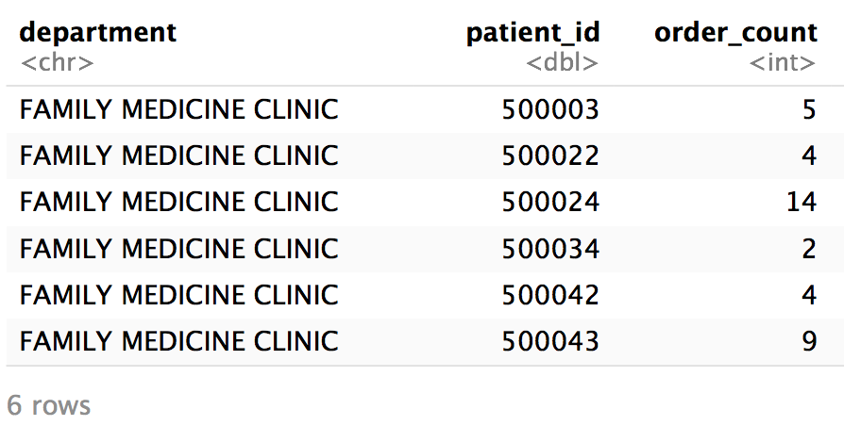
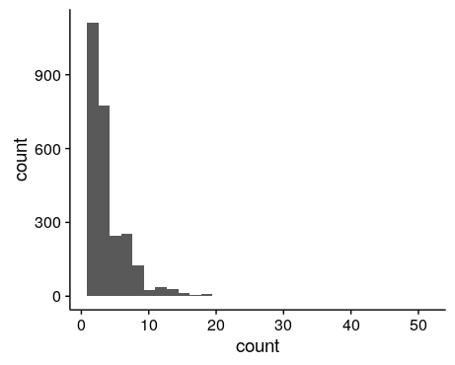

Visualize the distribution of order counts
orders_per_pt_dept
orders_per_pt_dept %>%
ggplot() +
geom_histogram(aes(x = order_count))
Notes:
We can plot a histogram using our ggplot skills. Note, here it could be informative to log-scale the axes or plot departments separately.
Order_count appears to not be normally distributed. There is a large right or positive skew. We could quantify the rightward skew in this population using the skew() function in the packages `psych` or `e1071`. A right-skewed distribution is very common for count variables, as well as many lab test results for which low values are much more common than higher values.

Slide 14
Your Turn 3
Another aesthetic mapping is "fill" - this can add a color to fill in the histogram based on another variable. Revise the plot we created by changing the fill of the histogram based on the department of the order.

Slide 15
Compare two sets of count data

Slide 16
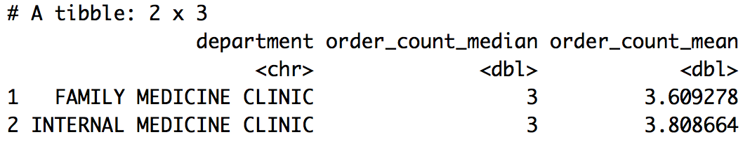
Describe the central tendency of the order count
orders_per_pt_dept
orders_per_pt_dept %>%
group_by(department) %>%
summarize(order_count_median = median(order_count),
order_count_mean = mean(order_count))
Notes:
Data appeared non-normally distributed with a rightward skew, so we see that our mean is higher than our median (as it is shifted right by rarer, high values).

Slide 17
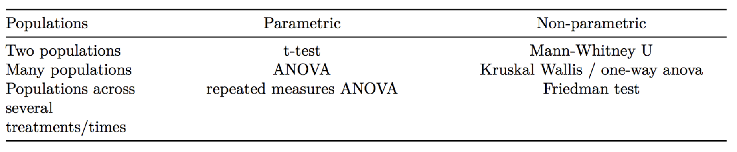
What test can compare count distributions?
Notes:
R has functions for common statistical tests

Slide 18
wilcox.test()
dependent or outcome variable
tilde operator
grouping or predictor variable
wilcox.test(measure ~ group,
data = orders, ...)
additional arguments
data frame
Compare distributions by rank order
Notes:
Mann-Whitney U-test or Wilcoxon rank-sum test evaluates the null hypothesis that a randomly sampled value from group 1 is equally likely to be greater than or less than a randomly sampled value from group 2. It tests whether the distribution of values in each group is the same

Slide 19
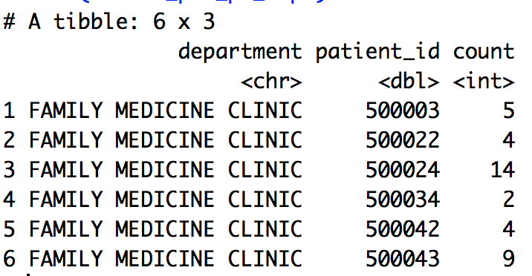
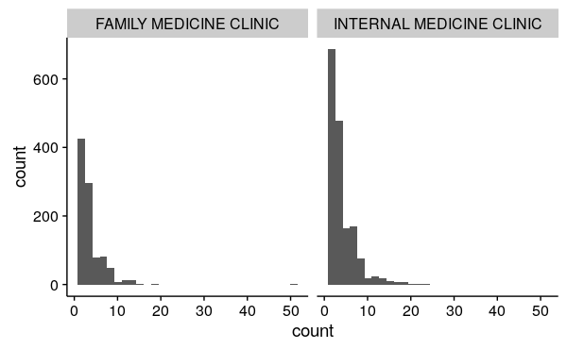
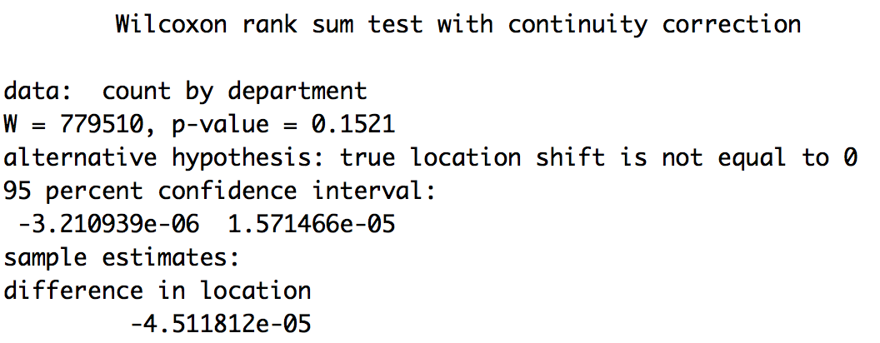
Compare order count distributions between 2 departments
orders_per_pt_dept
Wilcoxon rank-sum test
wilcox.test(order_count ~ department,
data = orders_per_pt_dept,
alternative = "two.sided",
paired = FALSE,
conf.int = TRUE)
Notes:
Interpretation: Results do not provide evidence for a difference in the number of tests ordered per patient between these two departments. P-value is not significant. Effect size estimate is very low (-4 x10^-5)

Slide 20
Your Turn 4
Compare order counts across the nephrology, cardiology, and gastroenterology departments.
*Hint: Convert department to a factor using function factor()

Slide 21
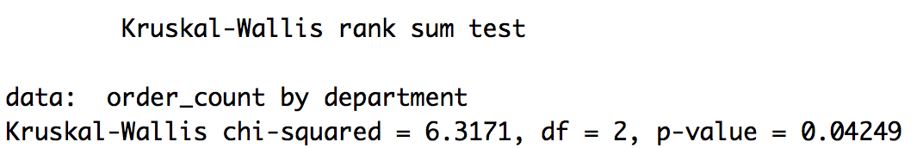
Compare order counts across the nephrology, cardiology, and gastroenterology departments
orders %>%
mutate(department = factor(department)) %>%
filter(department %in% c("NEPHROLOGY CLINIC",
"CARDIOLOGY CLINIC",
"GASTROENTEROLOGY CLINIC")) %>%
group_by(department, patient_id) %>%
summarize(order_count = n()) %>%
ungroup() %>%
kruskal.test(order_count ~ department,
data = .)
Notes:
Kruskal-Wallis test evaluates how likely it is that the distributions in the groups originate from the same distribution.
Interpretation: Results suggest the pt order counts are differently distributed in at least one of these departments
Note:
The `.` is a shortcut to refer to the data frame that is passed by the pipe operator %>%. This `.` is implied in tidyverse functions, but needs to be explicitly passed as a value for many other functions
The factor function converts the department variable from a character string to a factor. This data type is necessary for the grouping variable in the kruskal.test function
Would have been more efficient to apply the filter before the group_by-summarize

Slide 22
Objectives
Be able to…
Calculate basic statistical calculations for groups within a data set
Use standard statistical modeling functions
Compare variables’ distributions

